Slide 1
Game of Thrones
Network Analysis
Shaoting Zhang
Chenglin Yang

Slide 2
Introduction
Nodes(396) represent characters who ever speaks
Edges(2334) represent how many times two characters appear in the same scene
Sourses:
https://genius.com/albums/Game-of-thrones/Season-1-scripts
http://gameofthrones.wikia.com/wiki/Category:Characters?display=page&sort=mostvisited

Slide 3
How We Build The Network
First, we scrape all characters' names as nodes from the website.
Then we scan the scripts, split each scene and find all names in each scene as a set.
Finally we connect all name each other in one set.
Clustering Coefficients：0.278443813324

Slide 4
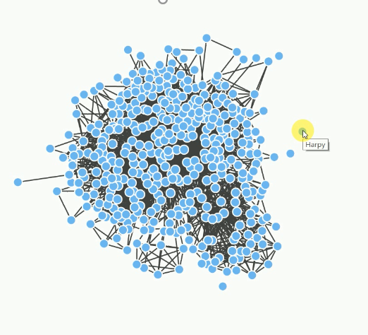
Network Limitations
Our list of characters is from book, so many nodes don't talk in the scripts, just as references.
Some nodes don't point to one person, such as soldier, man, dwarf. They have an effect on our analysis.

Slide 5
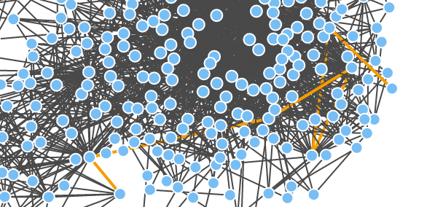
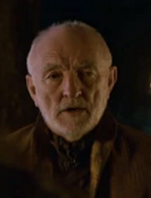
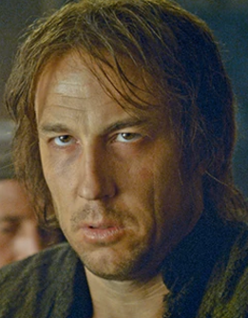
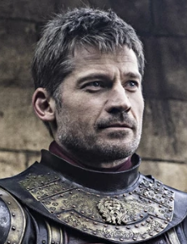
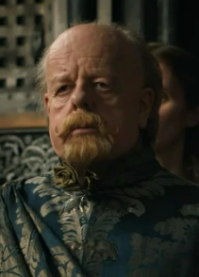
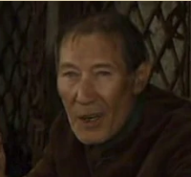
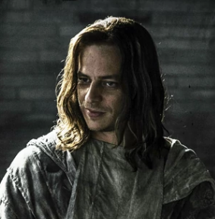
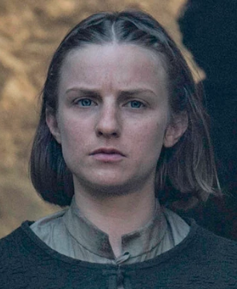
Diameter & Path
diameter == 7
Septon EdmureTully JaimeLannister MaceTyrell ThinMan Jaqen H'ghar Waif

Slide 6

Betweenness Centrality
1. Tyrion Lannister (0.1675)
2. Jon Snow (0.1402)
3. Man (0.1279)
4. Daenerys Targaryen (0.1078)
5. Arya Stark (0.0804)
6. Jaime Lannister (0.0734)
7. Sansa Stark (0.0669)
8. Cersei Lannister (0.0650)
9. Catelyn Stark (0.0467)
10. Jorah Mormont (0.0395)

Slide 7
Eigenvector Centrality
Degree Centrality
1. Jon Snow (337.0000)
2. Tyrion Lannister (321.0000)
3. Man (272.0000)
4. Cersei Lannister (258.0000)
5. Daenerys Targaryen (217.0000)
6. Sansa Stark (206.0000)
7. Arya Stark(177.0000)
8. Jaime Lannister (169.0000)
9. Catelyn stark (159.0000)
10. Jorah Mormont (152.0000)
1. Man (0.0488)
2. Tyrion Lannister (0.0409)
3. Cersei Lannister (0.0329)
4. Jon Snow (0.0291)
5. Sansa Stark (0.0252)
6. Varys (0.0201)
7. Jaime Lannister (0.0193)
8. Joffrey Baratheon (0.0170)
9. Daenerys Targaryen (0.0168)
10. Arya Stark (0.0159)

Slide 8
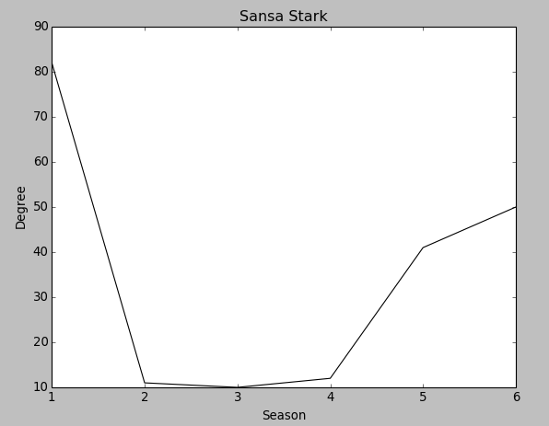
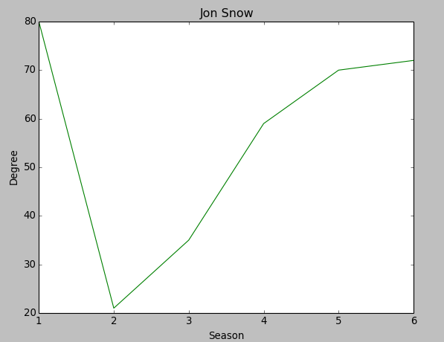


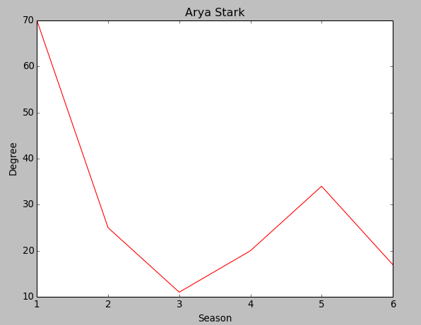
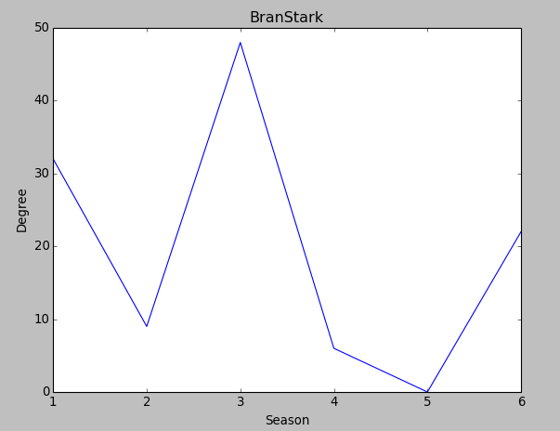
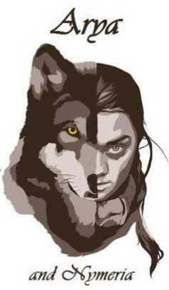
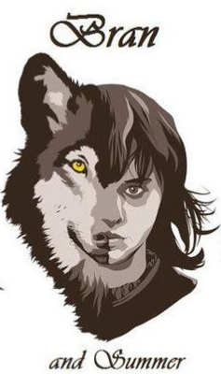
Degree Centrality

Slide 9
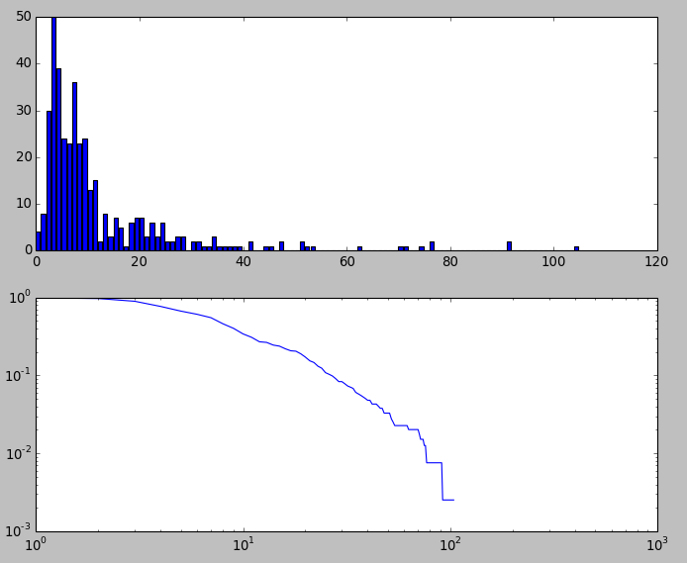

Power Law
alpha is 1.80

Slide 10
Diffusion Process
Problem:
In season 4 King Joffrey is
poisoned in his wedding. How this
message spread?
Source Node:
Maegaery Tyrell
Pertyr Baelish(main instigator)
Sansa Stark(fiancee)
Cersei Lannister(mother)

Slide 11
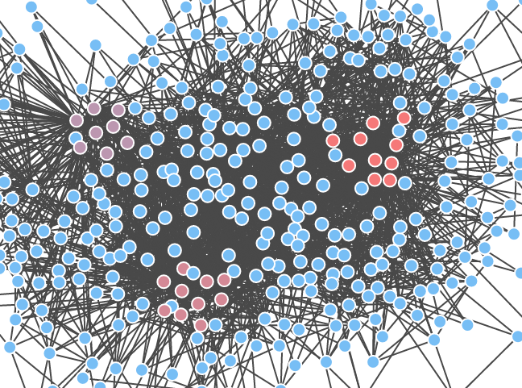
Modularity
Fraction of edges that connect nodes of the same type
Right: House Stark
Left: House Lannister
Underside: House Targaryen

